Slide 1
Sales/ Professional Services System Integration and Dashboard
Dynamics Integration to Planview and Creation of Client Dashboard
Utilizing Dynamics and Planview to support the Sales Pipeline Scoping Process
Lindsay Isbell
11.6.2020

Slide 2
In any given week Project Managers and subject matter experts from Professional Services spend 5-10 hours working with their sales team to finalize scope on established client deals in the pipeline. Most, if not all, of those hours go un-recognized and no tracking is available to support the business need/value of paid scoping engagements.

Slide 3
What’s The Problem?
Slow movement of large projects through the sales pipeline with little to no scoping completed on larger projects before signature
Dynamics and Planview require licenses
Entering projects today into both dynamics and Plainview is time consuming
Some projects/deals never make it out of dynamics but are worked on by professional services
No tracking of current project activity against pipeline deals
No way to view year over year client relationship and dollars spent on Professional Services
No view in Dynamics of resource availability within Professional Services for scoping engagements and project work
Professional services currently does not track client pipeline projects
No visibility into trends that are occurring with their projects ex: why are all Webkey projects delayed once they are started?

Slide 4
How will we address the problem?
Allow for the use of Planview fields to group similar projects
Analyze project descriptions for key words to show who has completed specific types of projects and recommend those projects for like clients
Use custom fields in Plainview to capture key information from Dynamics (sales person, etc)
Provides holistic view of client relationship and can offer insight into which clients have specific system features
Historical trends for the sales lifecycle– time to signature after involving Professional Services
Allow Project Managers and Account Managers to have the same view of a Client once the details of a deal can be made known
Allows for Professional Services teams to log non-billable time to a pipeline project instead of to sales support. Provides metrics around sales support efforts and project outcomes
Relevant pipeline flag in Dynamics today for when PS should get involved - Is professional services present? – Y/N field

Slide 5
Opportunities
Interface
An interface to automatically create projects in Planview reduces work for the project managers and shared services teams
Provides necessary client information to Sales and Professional Services
Reduces errors on data entry and allows for billing information to be pulled from Dynamics
Dashboard
Create trending reports based on Planview fields
To provide access and transparency to client relationships
See who clients have worked with in the past
Positive Business Outcomes
Drives business units to confirm to standardization of the scoping process which can generate additional revenue
Visibility into the client relationship
Automation of data would move the project through the pipeline at a more rapid pace

Slide 6
Who is Impacted?
Sales executives and account managers
Professional services teams
Clients with existing/pipeline projects

Slide 7
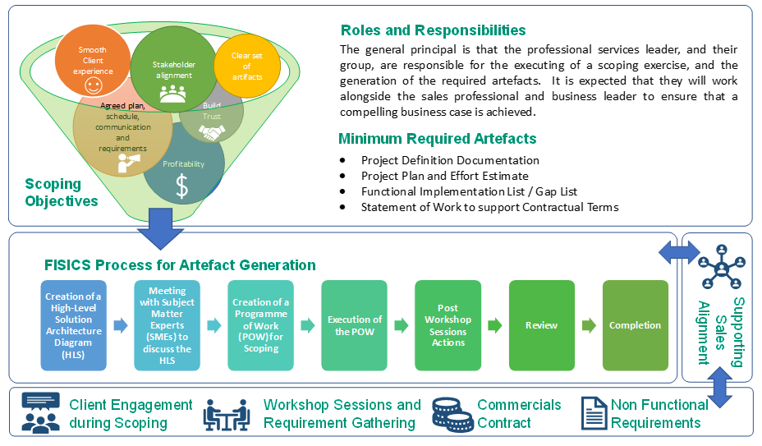
Sales/Account Managers Partnering with Professional Services

Slide 8
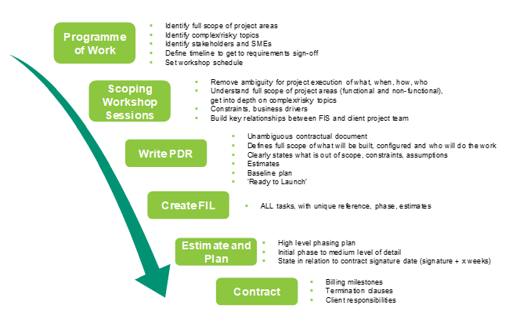

Slide 9
Group A – Team Composition
Lindsay Isbell
Project manager
Jeff Mayerhauser
Director, Practice Management
Project Manager 10+ years and with FIS 5+ years
Sofien Zairi
Background in process improvement and workflow consulting
Mark Luptak
Rafaele Courageot
Jayson Daw Program Manager-Technology
Point 1
Point 2
Point 1
Point 2
Gloria Shye
Point 1
Point 2
Point 1
Point 2
Point 1
Point 2
Point 1
Point 2

